Slide 1
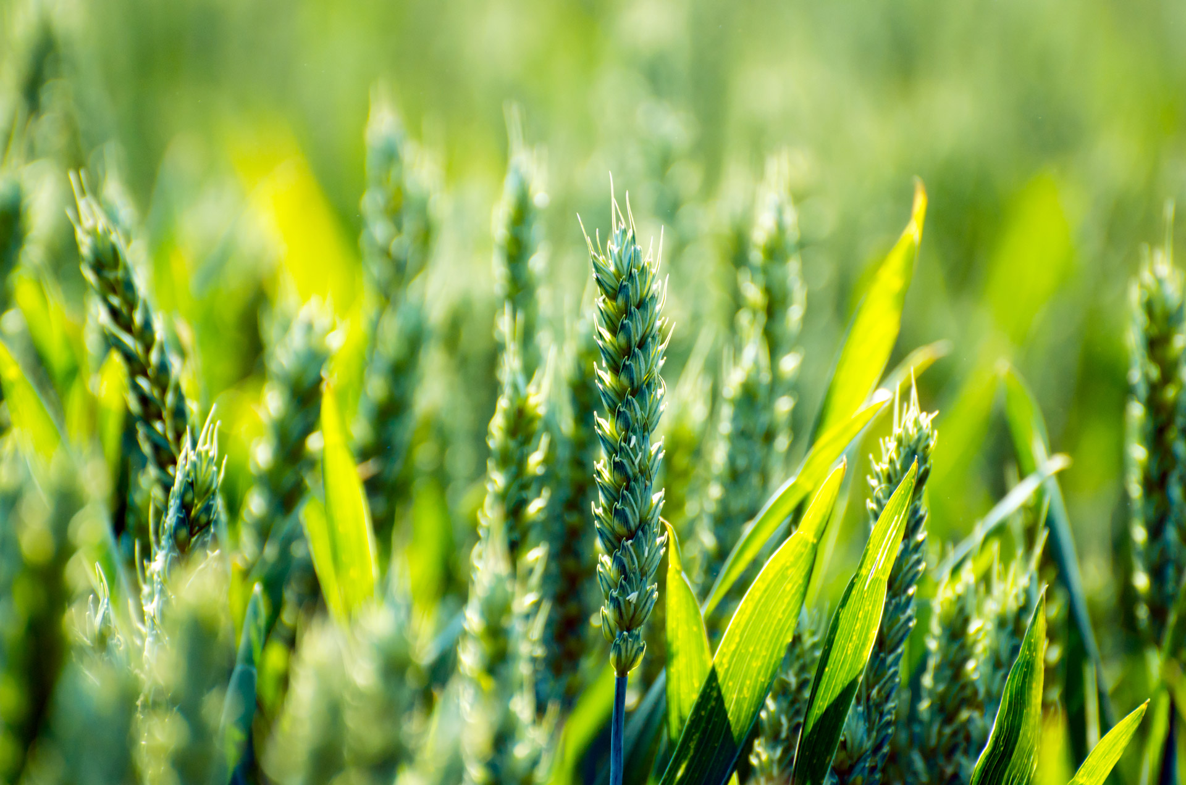
Crop Recommendation system
Supervised by: Dr. Zainab Hassan

Slide 2

Team Members
Moghazy Refaat
Omar Alaa
Mohammed Omar
Moaz
Ahmed Elide Ali
Ramadan
Ahmed Elsyed
Elsaeed
Omar Mohamed
Fawzy

Slide 3

Agenda
1.Overview
6.Result & Discussion
2.Related Work
7.Web App
3.Problem Statement & Motivation
8.Use case
4.Proposed Crop system Architecture
9.Concolusion
5.Hardware Component & Connection

Slide 4
1.Overview

Slide 5

The world's population is expected to reach 9.8 billion by 2050, increasing pressure on food resources. The world faces significant challenges in food production due to limited agricultural land, water scarcity, and climate change, in addition to the impact of pests, diseases, and extreme weather conditions on agricultural production.

Slide 6
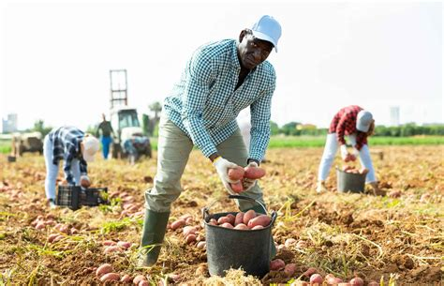

Slide 7
Egypt faces similar challenges, including scarcity of arable land, water shortages, and climate change, which threaten food security. Meeting these challenges is essential to ensure sustainable food production and economic stability in the country

Slide 8
2.Related Work

Slide 9
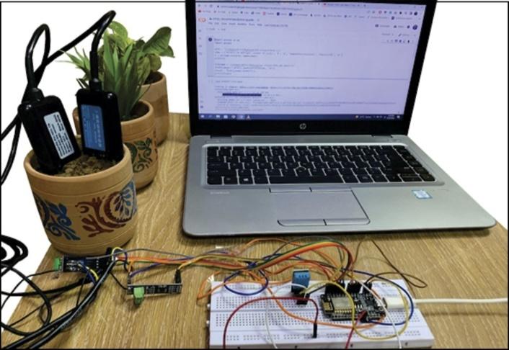
1.Some projects used a variety of different sensors to measure only the basic elements of the soil.
2. Some projects used ready-made datasets and applied classification of the crops via a mobile application.
3. Some projects relied on measuring the elements and sending them to the cloud for analysis and classification.
4. Our device is characterized by being a complete and independent device that can measure the seven soil elements while classifying the crops at the same time without the need for any external platforms.

Slide 10
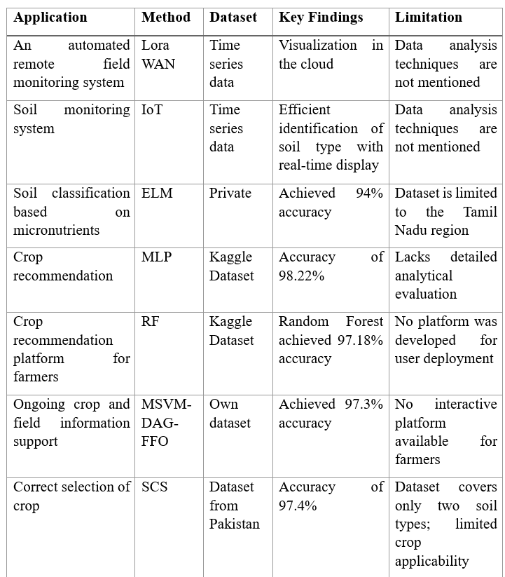
AgriBot vs Other system

Slide 11
3.Problem Statement & Motivation

Slide 12
Manual Soil Measurement Features
Laboratory Measurement of Essential Soil Nutrients (NPK) Steps
Sample Collection: Gather representative soil samples from the field, create composite samples, then bag and label them.
Sample Preparation: Air-dry, crush, grind, and sieve samples to obtain fine powder for analysis.
Nitrogen Analysis: Digest sample (Kjeldahl method) or extract nitrate/ammonium for spectrophotometric measurement.
Phosphorus Analysis: Extract available P with specific solutions, add color reagents, and measure color intensity via spectrophotometer.
Potassium Analysis: Extract available K and measure concentration using Atomic Absorption or Flame Photometer.
Reporting: Interpret results and provide recommendations based on measured nutrient levels.

Slide 13
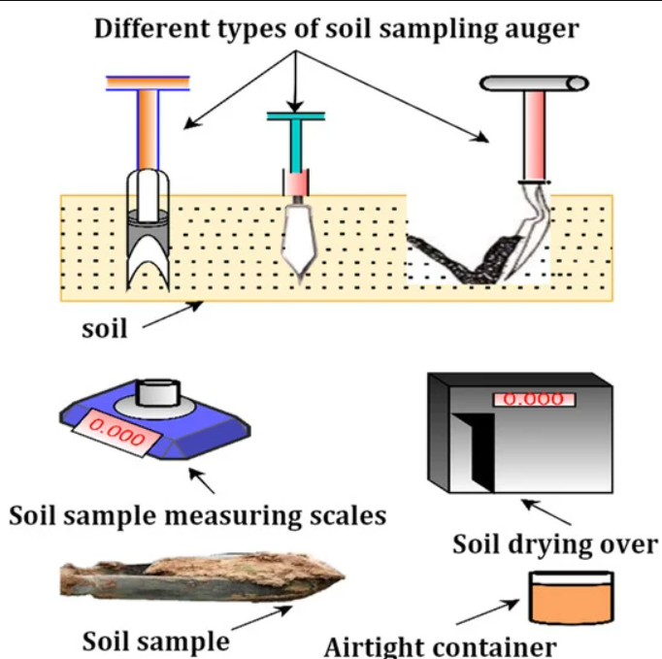
Real Steps

Slide 14
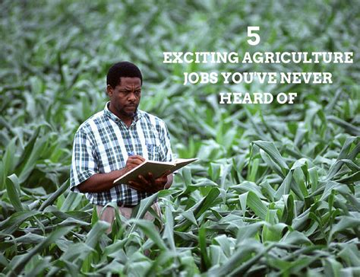

Slide 15
Motivations
1.Water scarcity and limited arable land in many regions. 2.Farmers struggle to choose the right crops for their soil. 3.Traditional methods of soil testing are time-consuming and expensive.

Slide 16
4. The process of measuring the soil manually takes a lot of time, effort, and cost, and it can take days.
5. The lack of soil elements leads to a decrease in crop production and a failure to meet the needs of increasing population.
6. It is difficult to determine the percentages of elements accurately due to the continuous changes in soil conditions and environmental factors.

Slide 17
4.Proposed Crop system Architecture

Slide 18
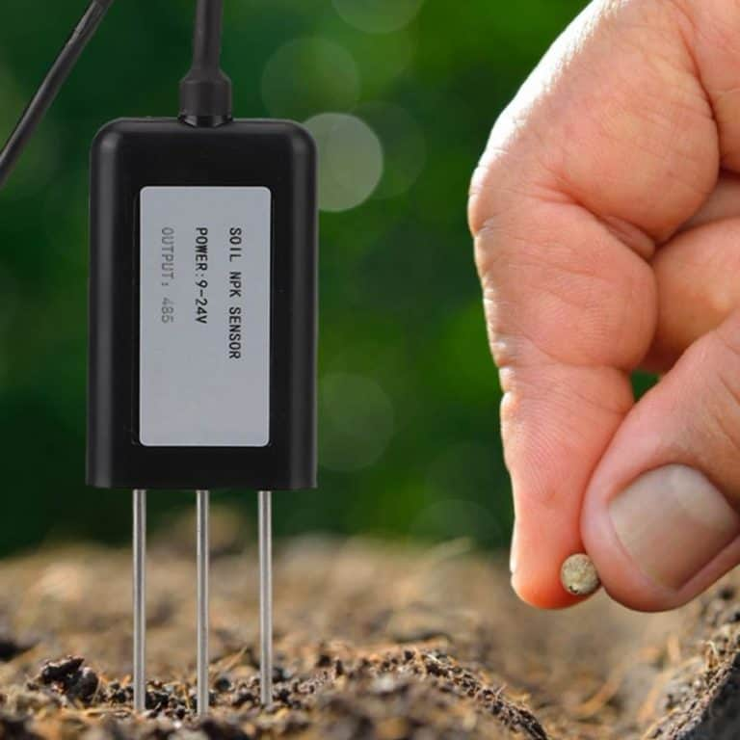
Soil sensor collects seven key soil metrics.

Slide 19
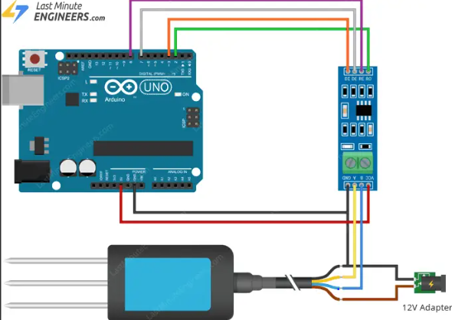
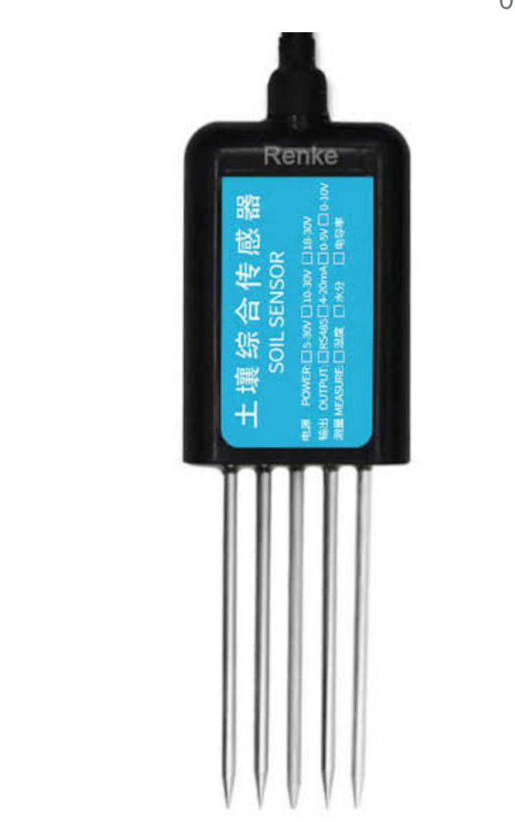
2.Arduino processes raw sensor data.

Slide 20

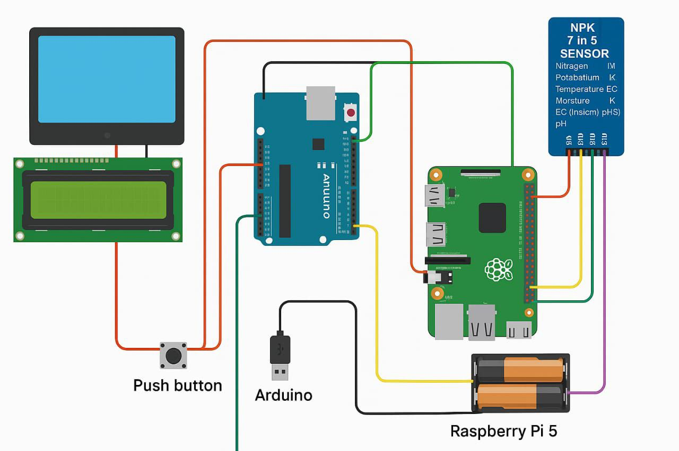
3.Data is sent to Raspberry Pi for analysis using ML

Slide 21
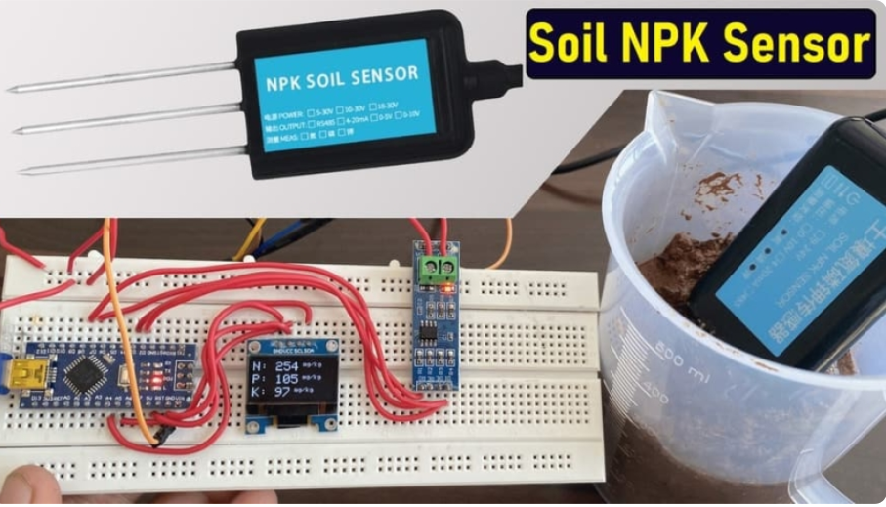
3.Results are displayed on a connected LCD screen.

Slide 22
5.Hardware Component & Connection

Slide 23
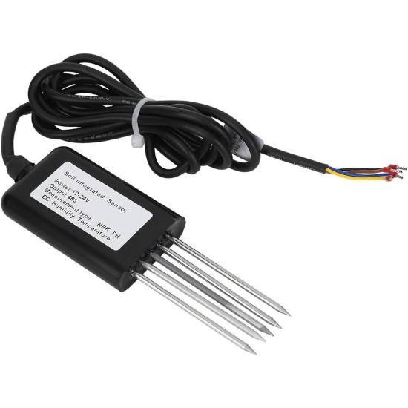
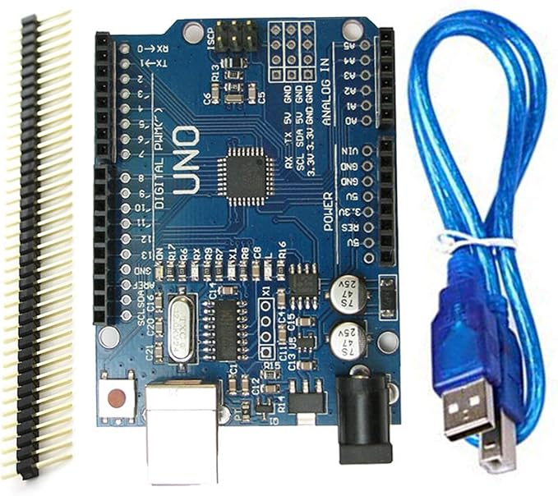
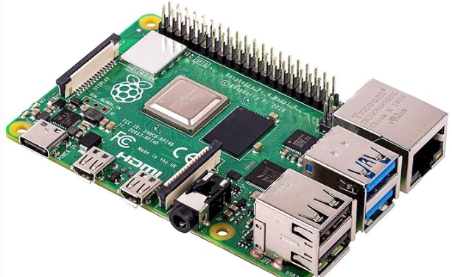
project component
NPK 7 in 5 sensor
Arduino Uno
Raspberry pi 5
Soil sensor measure 7 component
Collect component and send to raspberry pi
Make crop recommendation

Slide 24
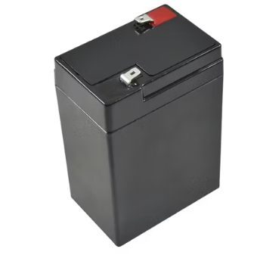
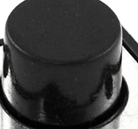
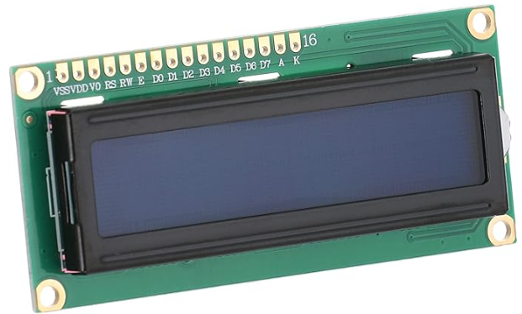
Batteries
Button
LCD

Slide 25
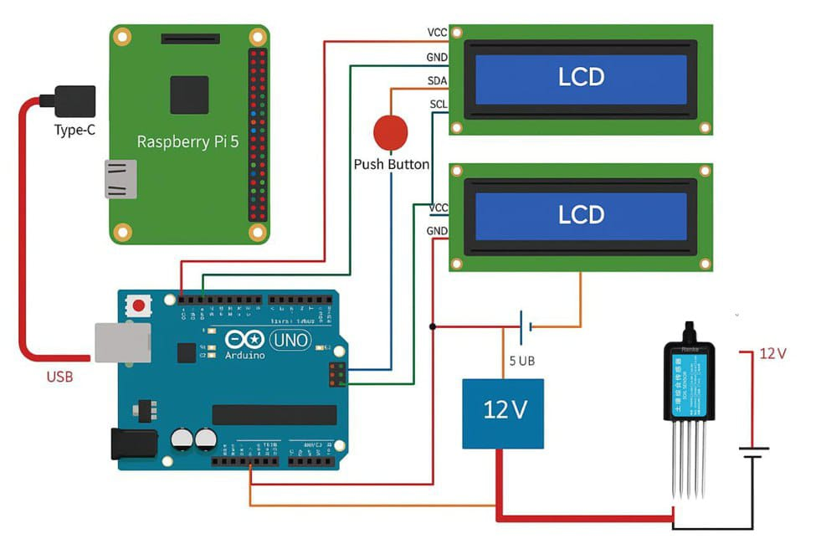
Circuit and Connections

Slide 26
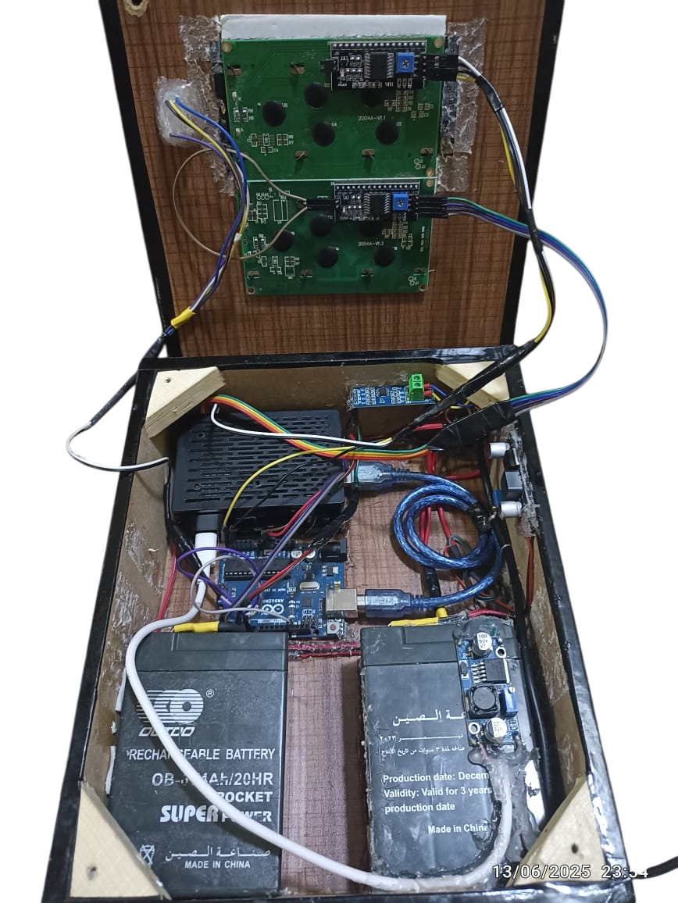
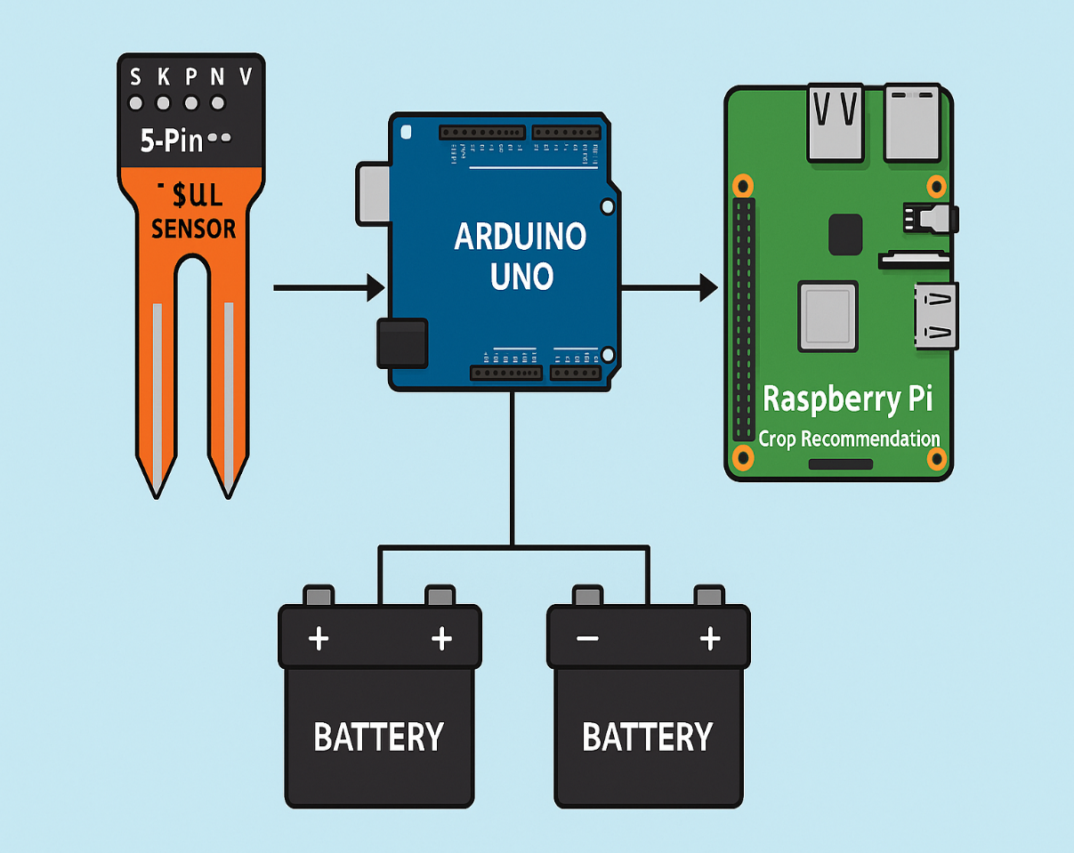

Slide 27
Challenges During Connection
Collecting high-quality soil data for training.
Integrating multiple hardware components smoothly.
Ensuring power efficiency in rural environments.

Slide 28
6.Result & Discussion

Slide 29
Why ML model
1.Analyze complex patterns in soil and climate data.
2.Recommend the best crops based on real-time conditions.
3.Adapt and improve over time as more data is collected.
4.Save time, reduce costs, and increase productivity.

Slide 30
Crop recommendation system Flowchart diagram
start
start
Restart
Read soil parameter using NPK sensor
no
Is data received
yes
Extract 7 elements from soil N, P ,K
Send data to trained ML model
ML model predicate best crops
ML model predicate best crops
end
end
Display crops
Display crops

Slide 31
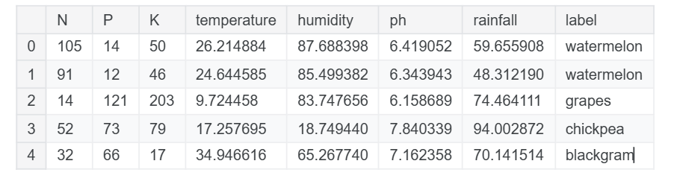
Dataset

Slide 32
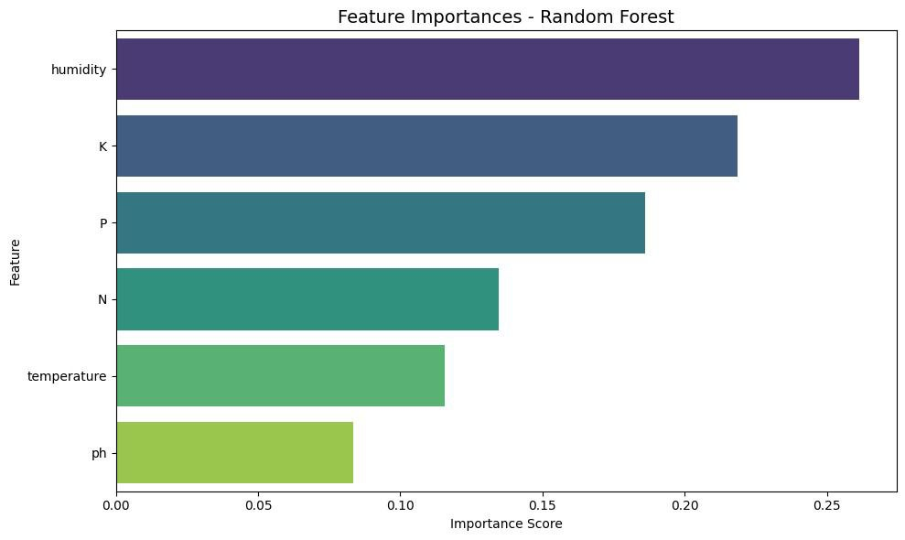
Features

Slide 33
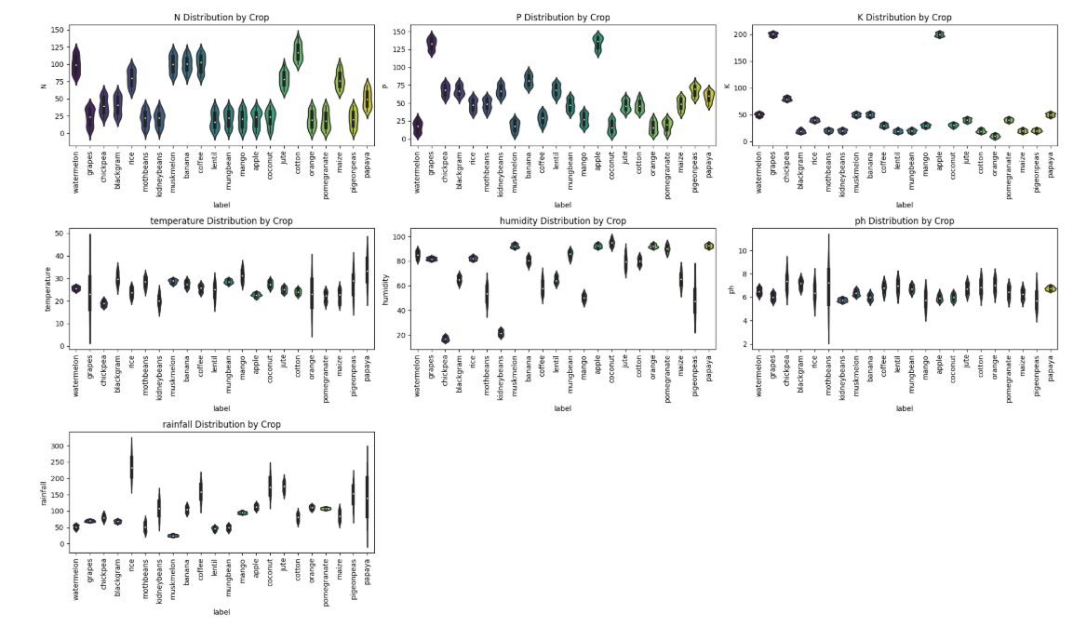
Distributing of by feature by crops

Slide 34
Results
Model | accuracy | precision | recall | f1
LogisticRegression | 0.9159 | 0.9225 | 0.9159 | 0.9154
DecisionTreeClassifier | 0.9682 | 0.9710 | 0.9682 | 0.9685
RandomForestClassifier | 0.9728 | 0.9761 | 0.9727 | 0.9733
LGBMClassifier | 0.9636 | 0.9664 | 0.9636 | 0.9639
SVC | 0.8750 | 0.8675 | 0.8750 | 0.8575

Slide 35
7.Web App

Slide 36
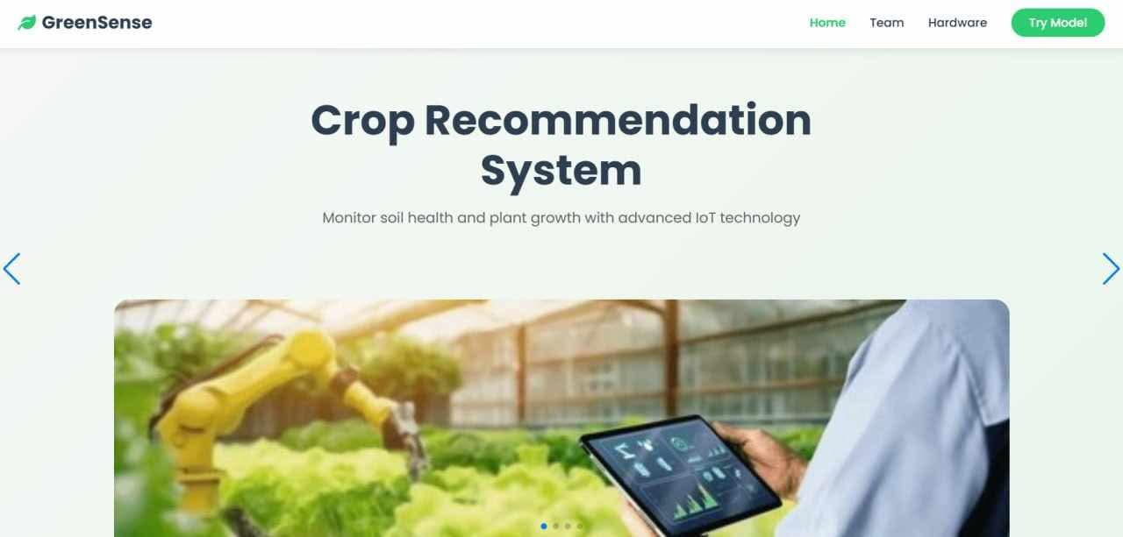
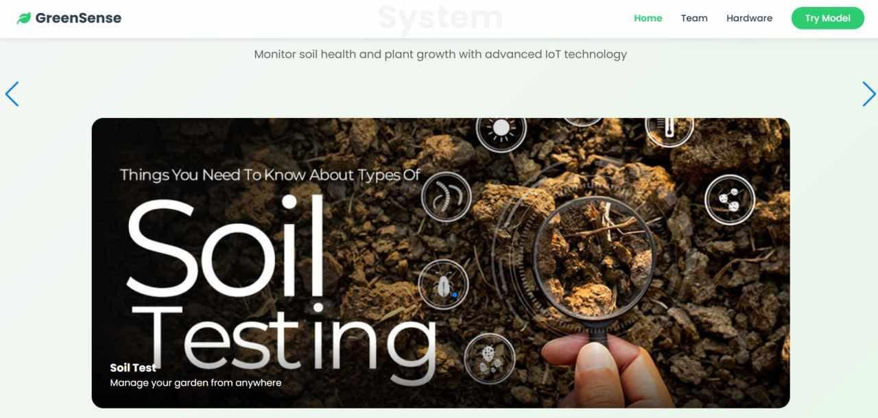
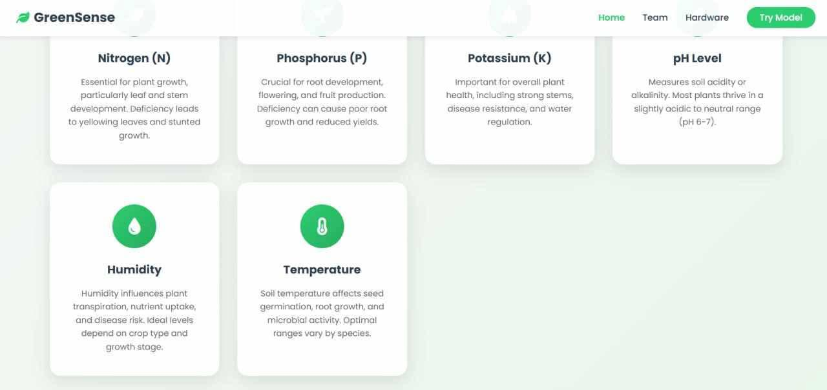
Web App

Slide 37
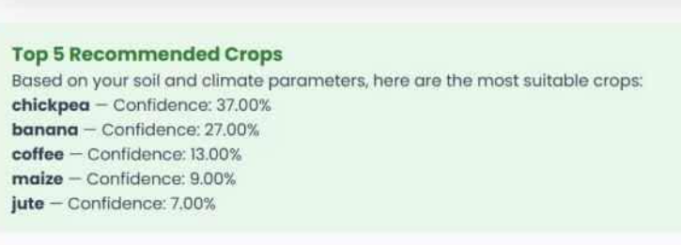
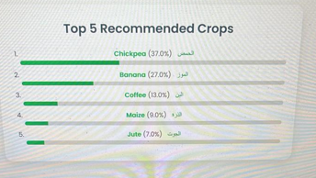
Page link:http://127.0.0.1:5500/

Slide 38
8.Use cases

Slide 39
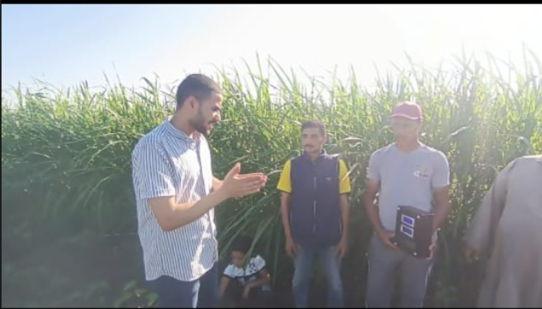
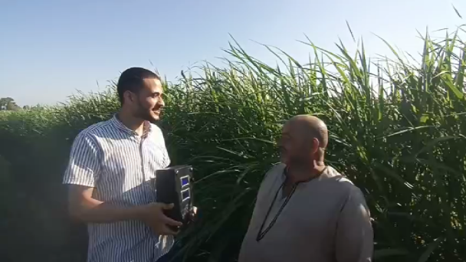
Use case.1
In model farms such as "Sers El-Layan" in Menoufia, devices have been installed to measure soil moisture and accurately determine water requirements. Similar devices were also used in another area, "Toshka," in cooperation with the Dutch company NEDERKO. According to World Bank reports, this led to a 25% reduction in water consumption in that region.
In the UAE, artificial intelligence is being used in the "Digital Dhabian Forests" project to monitor desertification and increase green coverage.

Slide 40
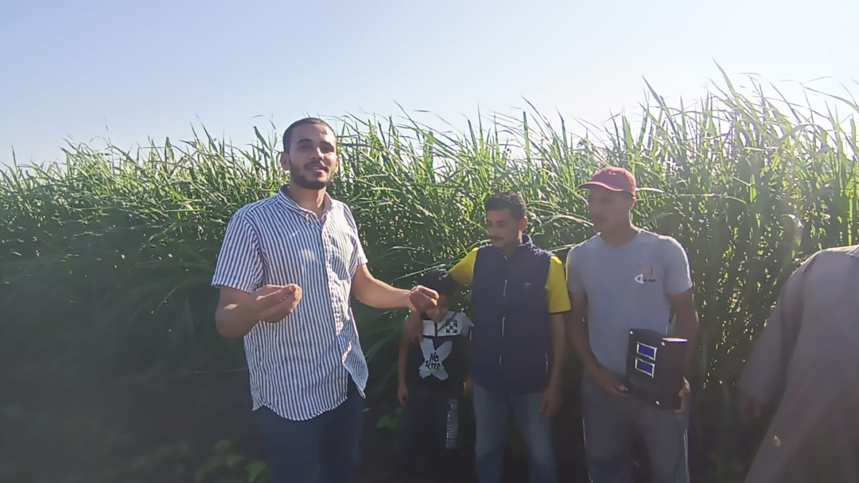
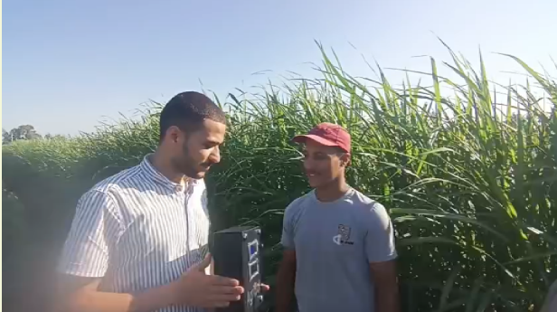
Use case.2
Selecting the best cultivars suitable for the soil – enhancing crop success rates.
Keeping pace with population growth and increasing agricultural production – helping to avoid famine.
Saving water used for irrigation – through precise recommendations based on soil needs.

Slide 41
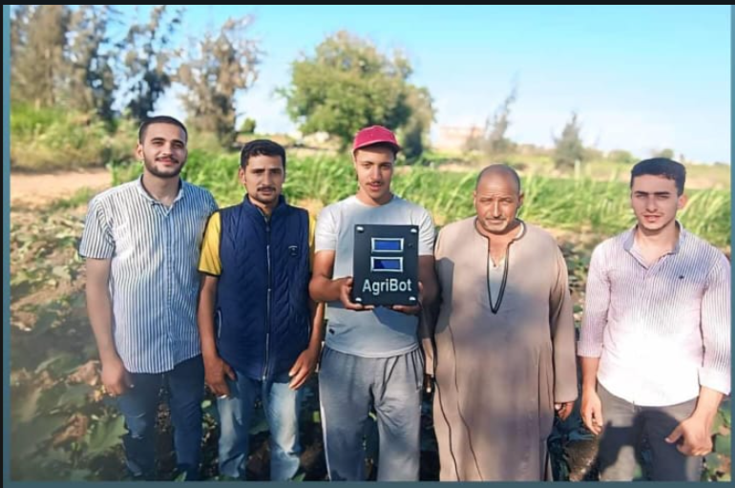

Slide 42
9.Concolusion

Slide 43
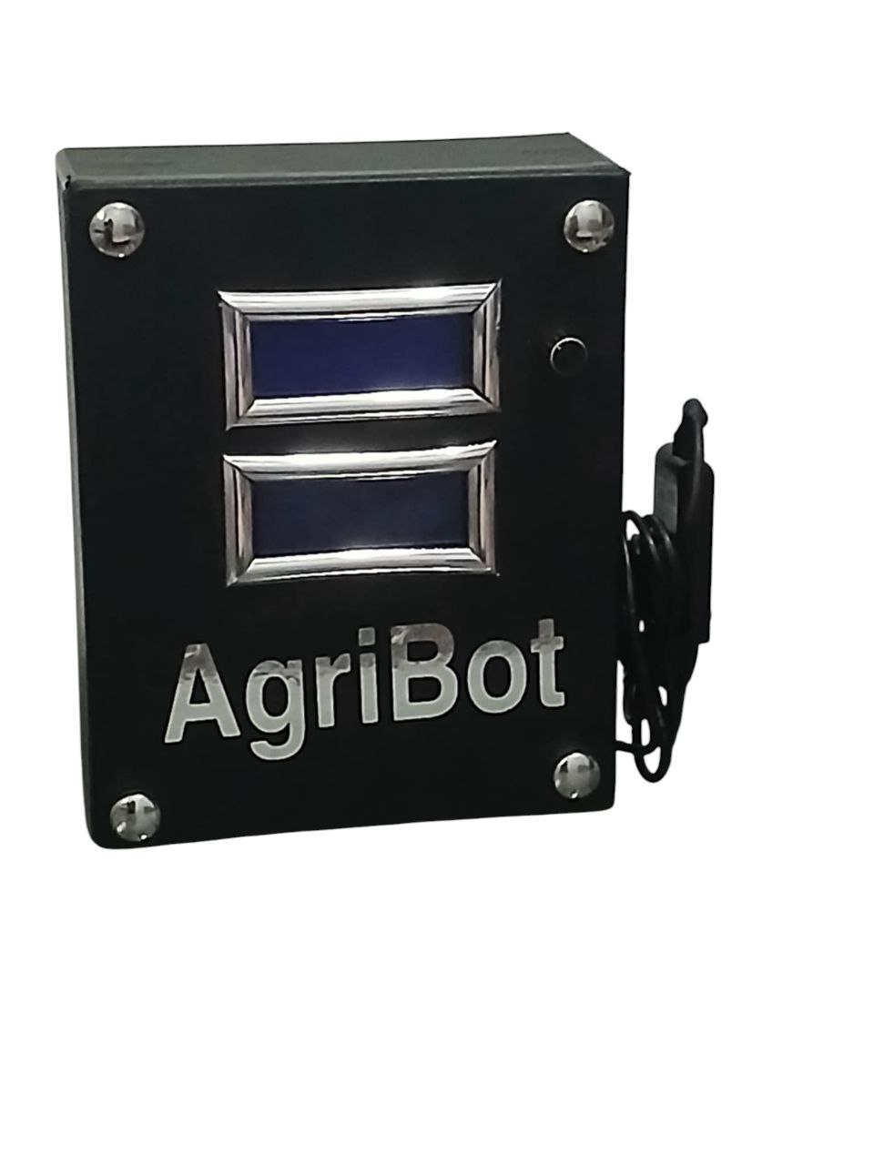
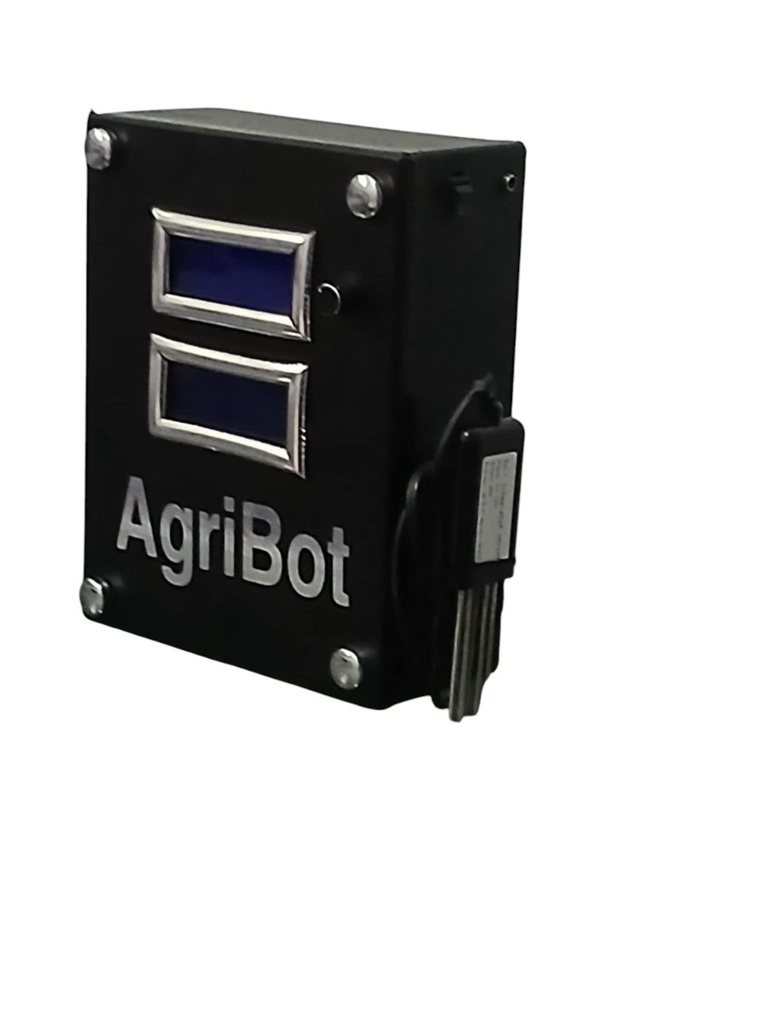
Device
The NPK Bot offers an innovative solution for smart agriculture.
It bridges the gap between soil analysis and crop selection.
A step forward in sustainable, tech-driven farming

Slide 44
Thanks!
Do you have any questions?

